Slide 1
CloudCart
Online Shopping Portal
AWS Cloud & DevOps Internship Project
React · Spring Boot · MySQL · Docker · Kubernetes · AWS

Slide 2
INTRODUCTION
A cloud-native shopping portal
CloudCart is a secure, scalable e-commerce application where customers browse products, manage a cart, and place orders — while administrators manage the catalog, inventory, and sales through a dedicated dashboard. The system is built to be deployed on AWS using containers, orchestration, and an automated delivery pipeline.
18+
11
REST API endpoints
database tables
2
7
user roles (customer / admin)
AWS services used
02

Slide 3
PROBLEM STATEMENT
Why build this
1
Small and mid-size sellers need an affordable, cloud-hosted storefront without managing physical servers.
2
Manual inventory and order tracking leads to overselling, stockouts, and slow fulfillment.
3
Traffic spikes (sales, festivals) demand infrastructure that scales automatically, not manual intervention.
4
Security expectations (encrypted passwords, role-based access) are often skipped in student/hobby projects.
03

Slide 4
OBJECTIVES
What the project set out to do
Secure by design
Well-modeled data
Fully containerized
JWT auth, BCrypt hashing, role-based access control
Normalized MySQL schema with keys, indexes, constraints
Docker images for frontend and backend, verified with Compose
Orchestrated at scale
Automated delivery
Cloud-native on AWS
Kubernetes Deployments, Services, Ingress, and HPA
GitHub Actions: build → test → image → deploy → notify
RDS, S3, SNS, ALB, Auto Scaling, CloudWatch, IAM
04

Slide 5
SYSTEM DESIGN
Architecture overview
React SPA
Nginx
ALB
Spring Boot API
Amazon RDS
→
→
→
→
Customer & Admin UI
Static hosting + reverse proxy
AWS Load Balancer
EKS pods (autoscaled)
MySQL 8
Supporting AWS services
CI/CD flow
• S3 — product images
1. Push to main
• SNS — order notifications
2. GitHub Actions: build & test
• CloudWatch — logs & metrics
3. Docker image → Docker Hub
• IAM — scoped access via IRSA
4. kubectl apply → EKS
• Auto Scaling — node-level scaling
5. SNS deploy notification
05

Slide 6
CLOUD PLATFORM
AWS services used
EC2 / EKS
RDS (MySQL)
S3
IAM
Compute for hosting containerized services
Managed relational database
Product image storage
Fine-grained access control
CloudWatch
SNS
ALB
Auto Scaling
Logs, metrics, health monitoring
Order & deployment notifications
Layer-7 load balancing / routing
Elastic capacity on demand
06

Slide 7
DATA MODEL
Database design
users
roles
user_roles
categories
products
cart
cart_items
orders
order_items
payments
reviews
wishlist
Every table uses primary keys, foreign key relationships, and unique constraints (e.g. one cart per user, one review rating range 1–5). Indexes cover common lookups: products by category, orders by user and status, reviews by product.
CREATE TABLE orders (
id BIGINT AUTO_INCREMENT PRIMARY KEY,
user_id BIGINT NOT NULL,
status ENUM('PENDING','CONFIRMED','SHIPPED','DELIVERED','CANCELLED'),
CONSTRAINT fk_orders_user FOREIGN KEY (user_id) REFERENCES users(id)
);
07

Slide 8
FUNCTIONALITY
Core features
Customer
Admin
• Register / login with JWT
• Role-restricted secure login
• Browse, search & filter products
• Add / update / soft-delete products
• Product details, ratings & reviews
• Manage categories & inventory
• Cart with live quantity & totals
• View & manage all customer orders
• Checkout with address & payment method
• Revenue & order-count dashboard
• Order history & cancellation
• Customer account overview
08

Slide 9
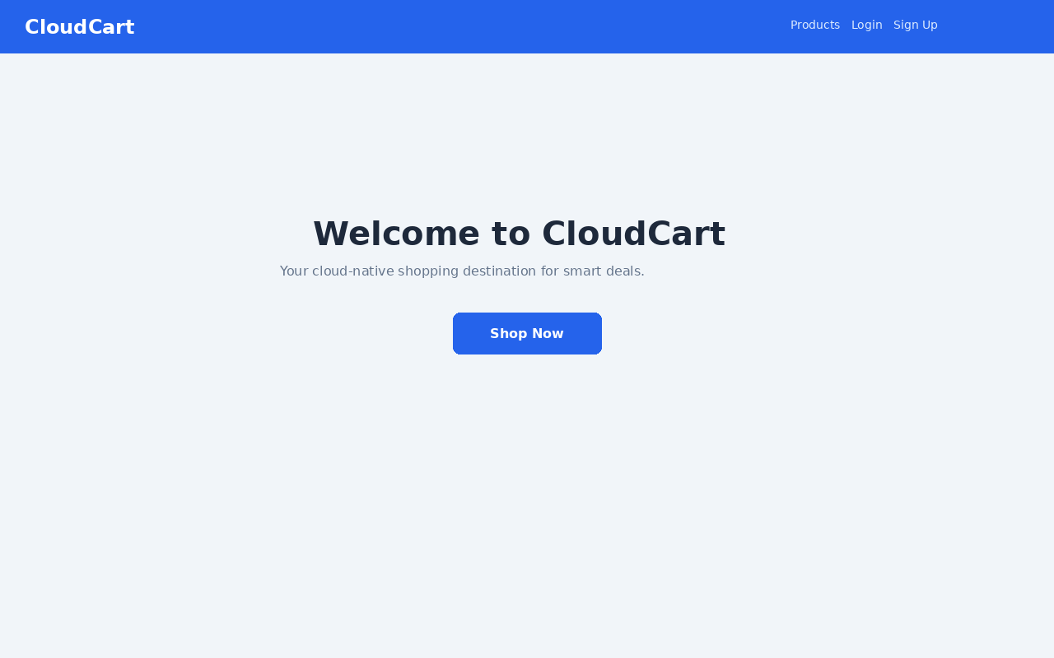
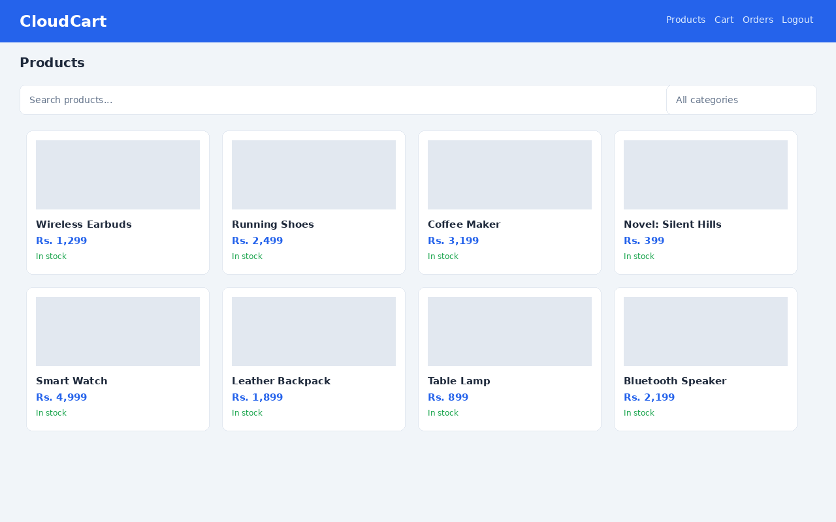
SCREENS
Application screenshots
Home page
Product catalog
09

Slide 10
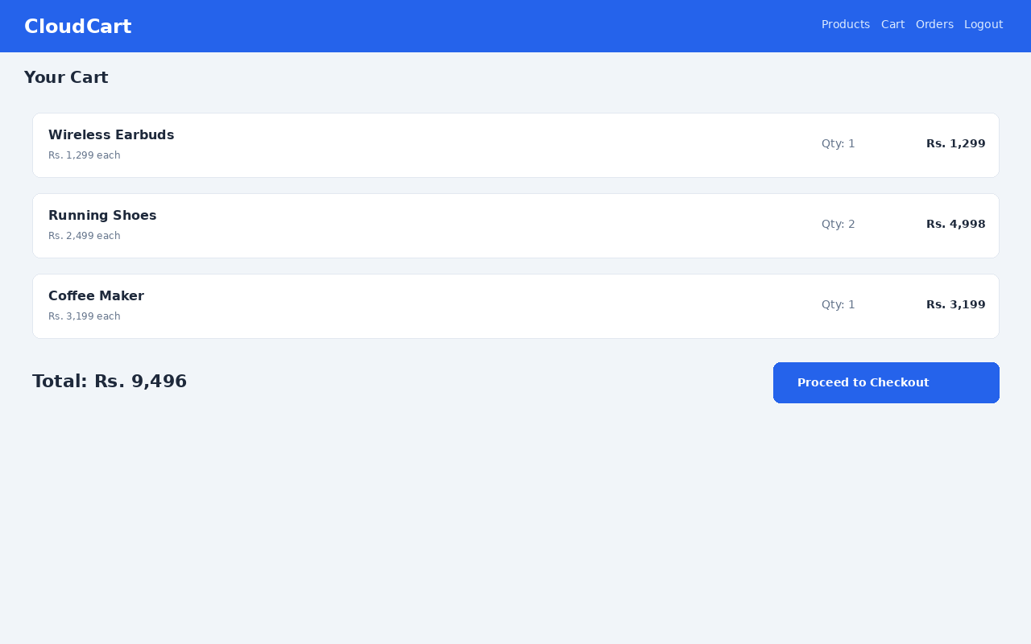
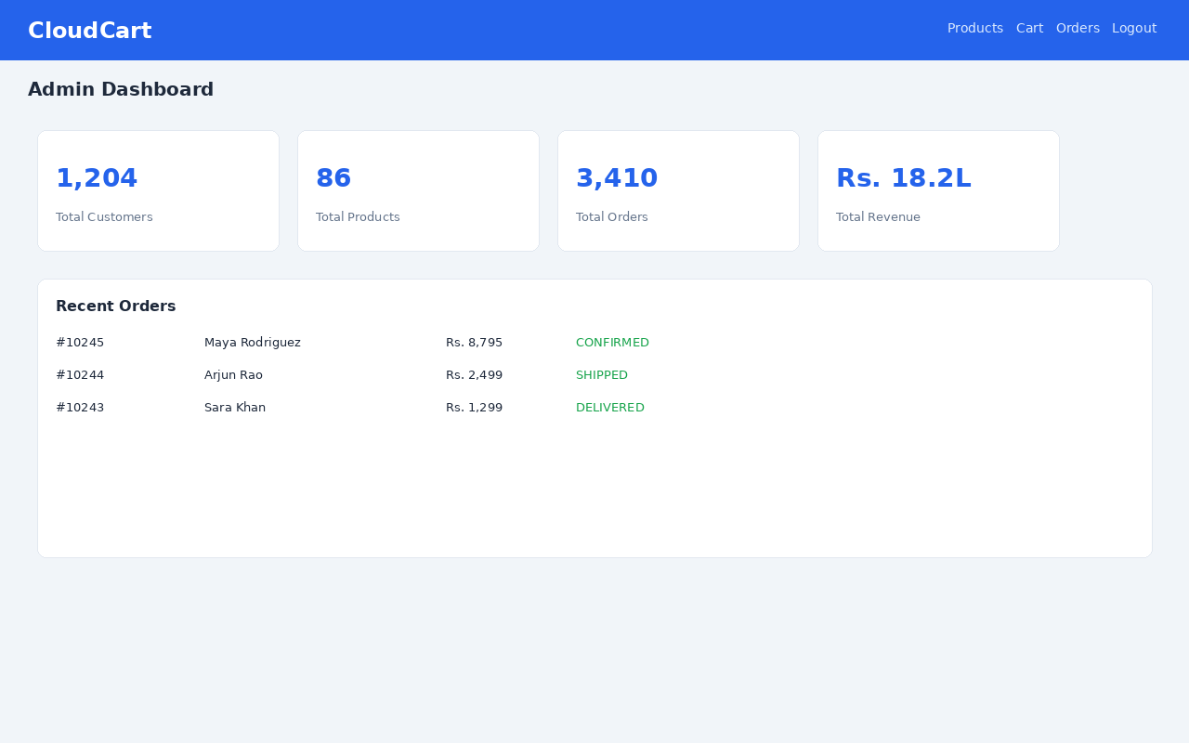
SCREENS
Application screenshots
Shopping cart
Admin dashboard
10

Slide 11
CONTAINERIZATION
Docker
Frontend and backend each ship as independent, minimal images — a multi-stage Maven build for the Spring Boot jar, and a Node build served through Nginx for the React app. docker-compose.yml wires both together with MySQL for full local integration testing.
FROM eclipse-temurin:17-jre-jammy
WORKDIR /app
USER spring:spring
COPY --from=build /app/target/cloudcart-backend.jar app.jar
EXPOSE 8080
HEALTHCHECK CMD wget -qO- \
http://localhost:8080/api/actuator/health
ENTRYPOINT ["java", "-jar", "app.jar"]
• Dockerfile.backend — Maven build → JRE runtime, non-root user
• Dockerfile.frontend — Node build → Nginx static serve
• docker-compose.yml — mysql + backend + frontend, healthchecks wired
• Environment variables externalized via .env
11

Slide 12
ORCHESTRATION
Kubernetes
Namespace
ConfigMap / Secret
Deployments
Isolates all CloudCart resources
Externalized config and credentials
2+ replicas each for frontend & backend
Services
Ingress (ALB)
HPA
Stable internal networking (ClusterIP)
Public routing for / and /api
Autoscale 2→8 pods on CPU/memory
12

Slide 13
AUTOMATION
CI/CD pipeline — GitHub Actions
1
2
3
4
5
6
Checkout & build
→
Run backend + frontend tests
→
Build Docker images
→
Push to Docker Hub
→
Deploy manifests to EKS
→
Notify via SNS
Triggered on every push to main. Pull requests run build & test only — image push and deploy are gated to main so the cluster only ever runs reviewed, tested code.
13

Slide 14
OUTCOMES
Results
11
18+
2
6
database tables, fully normalized with FKs & indexes
REST endpoints across auth, catalog, cart, orders, admin
roles enforced end-to-end (customer / admin)
Kubernetes manifest types, HPA-scaled 2→8 pods
The full stack runs end-to-end via Docker Compose locally, with Kubernetes manifests and a GitHub Actions pipeline ready to deploy the same images to an AWS EKS cluster.
Scope note
Live AWS metrics and production traffic are out of scope for this internship-stage submission; the architecture and pipeline were validated locally.
14

Slide 15
Conclusion
CloudCart demonstrates a complete cloud-native application lifecycle — secure authentication, a well-modeled relational database, containerized services, Kubernetes orchestration with autoscaling, and an automated CI/CD pipeline targeting AWS.
Future enhancements
• Payment gateway integration
• Expanded automated test coverage
• CloudWatch alarms & dashboards
• IAM least-privilege review
Thank you

